Slide 1
SMART ALERT VENTILATION system Graphic Era deemed to be University Dehradun
Guided By: Submitted By :
Dr.Sachin Sharma Ayush Kumar
Associate Professor Roll no. : 2011701
GEU Dehradun Sem. : 6th

Slide 2
What is the need?
Poor room air quality leads to many diseases.
Accumulation of harmful gases (carbon monoxide) may be fatal.

Slide 3
Factors affecting air quality
Particulate matter (PM10 and PM2.5)
Ozone (O3)
Nitrogen dioxide (NO2)
Carbon monoxide (CO)
Sulphur dioxide (SO2)
High temperatures
High humidity

Slide 4
Components Required:
Arduino Uno R3
DHT 11
MQ135 gas sensor
ESP8266 wifi module
Breadboard
Jumper wires

Slide 5

Hardware
Arduino Uno

Slide 6

DHT 11

Slide 7
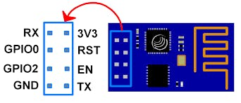
ESP8266 Wi-Fi Module

Slide 8
The pinout is as follows for the common ESP-01 module:
VCC, Voltage (+3.3 V; can handle up to 3.6 V)
GND, Ground (0 V)
RX, Receive data bit X
TX, Transmit data bit X
CH_PD, Chip power-down
RST, Reset
GPIO 0, General-purpose input/output No. 0
GPIO 2, General-purpose input/output No. 2

Slide 9

MQ-135 Gas sensor

Slide 10
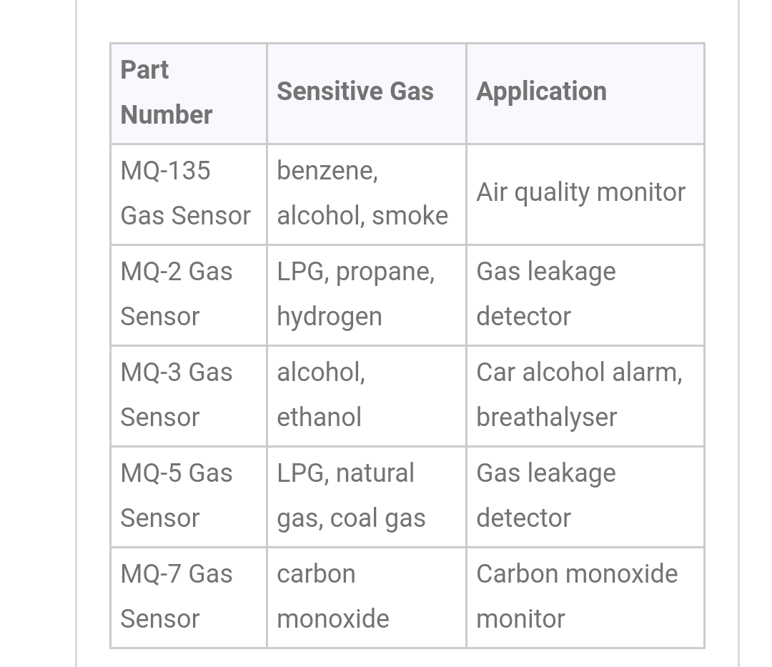
Selection Guide:

Slide 11
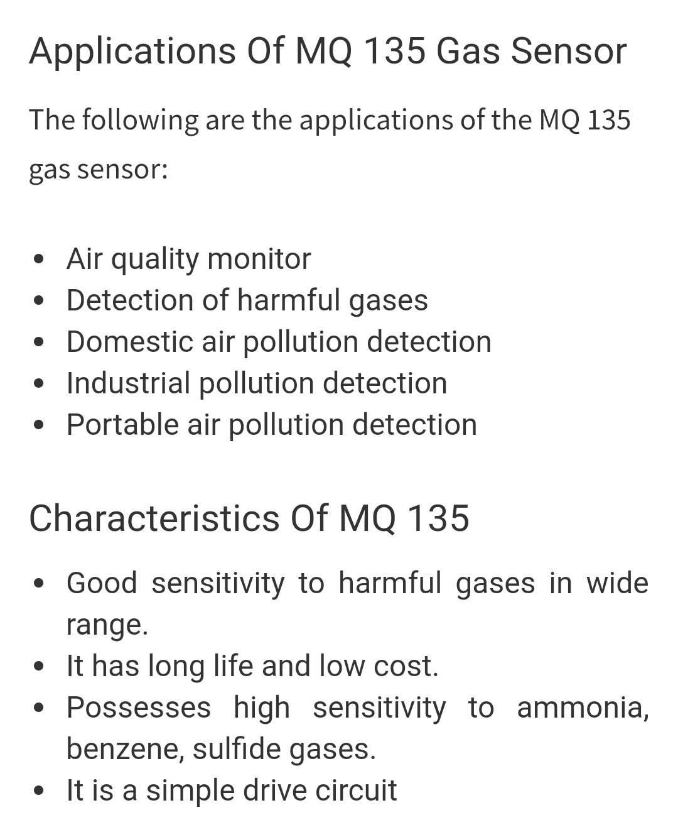

Slide 12
Software Required
Arduino IDE
IBM Cloud

Slide 13
Working Principle
Sensors senses the room air quality components.
Sensors analog data is conveted into digital data by Arduino Uno.
This Digital data is sent to the cloud by using wifi module ESP 8266-01
The following data is analysed and smart ventilation window ventilates the room and give a notification to the close relative in case room air quality is dangerous.

Slide 14
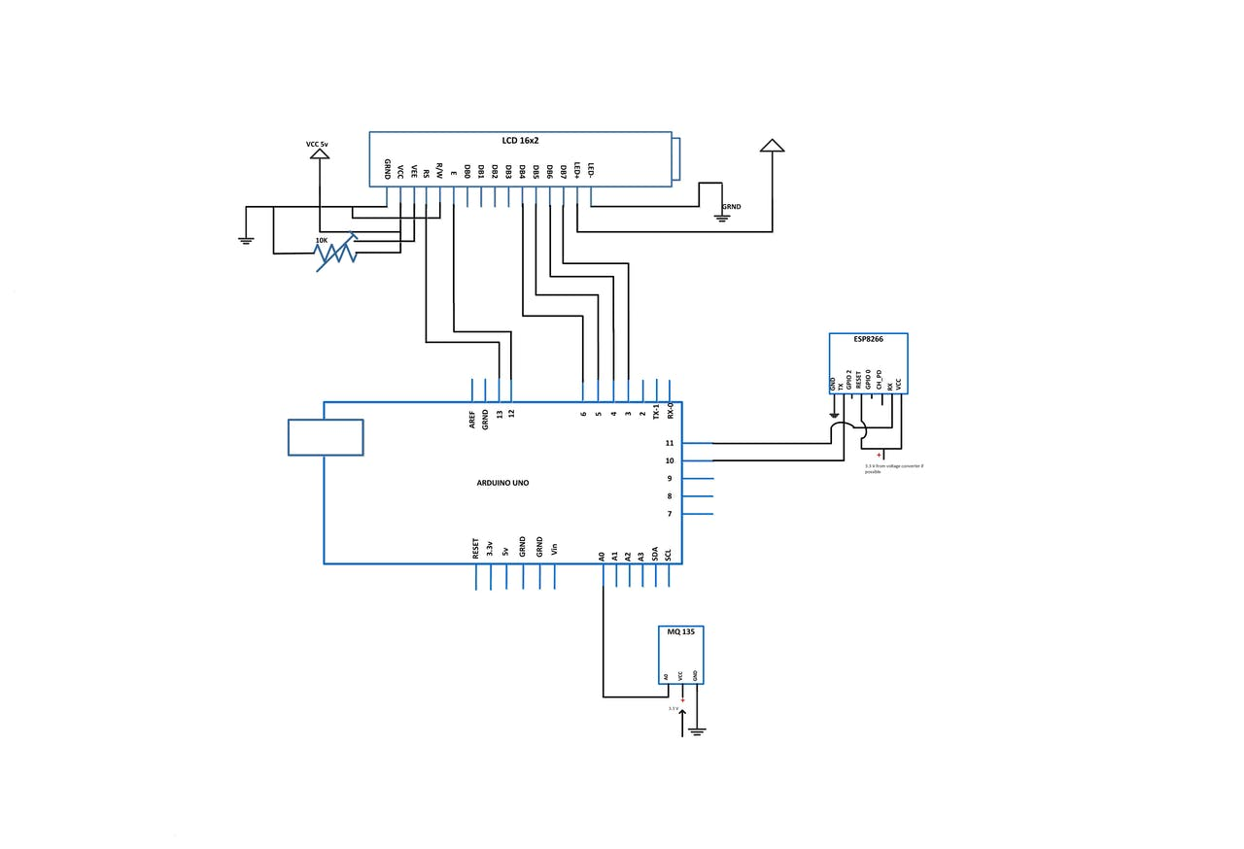
Circuit Diagram

Slide 15
Connections:
Arduino ==> LCD
GND ==> GND
5 V ==> Vcc
D13 ==> RS
GND ==> R/W
D12 ==> Enable
D6 ==> DB4
D5 ==> DB5
D4 ==> DB6
D3 ==> DB7
5V ==> LED+
GND ==> LED-
Arduino ==> Gas sensor
GND ==> GND
3.3 V ==> Vcc
Analog0 ==> A0
Arduino ==> ESP8266
D10 ==> Tx
D11 ==> Rx

Slide 16
Usefulness:
It may serve as a life saving device.

Slide 17
THANK YOU....

